Slide 1
Relationships between crime and income!
Team Members: Delayna Bradshaw, Kerry Kovacik, Michael Kung, Tito Odunsi

Slide 2
Hypothesis!
There is an inverse relationship between income and crime in the city of Austin, Texas.

Slide 3
Data Sources, Exploration and Analysis!
Austintexas.gov (https://data.austintexas.gov/resource/mfej-x5pm.json)
Census (Census API)

Slide 4
Data exploration and clean up process!
For census data, we used an API key to pull 2011 & 2016 data by zip code.
For crime data, we filtered the CSV files to gather data for crimes that occurred in 2011 & 2016.
Gathered the list of Austin zip codes from the crime data, used a for-loop to pull those zip codes from the census data.
Merged the years (2011 and 2016) into the same data frame.
For crime, we also counted the crimes per zip codes.

Slide 5
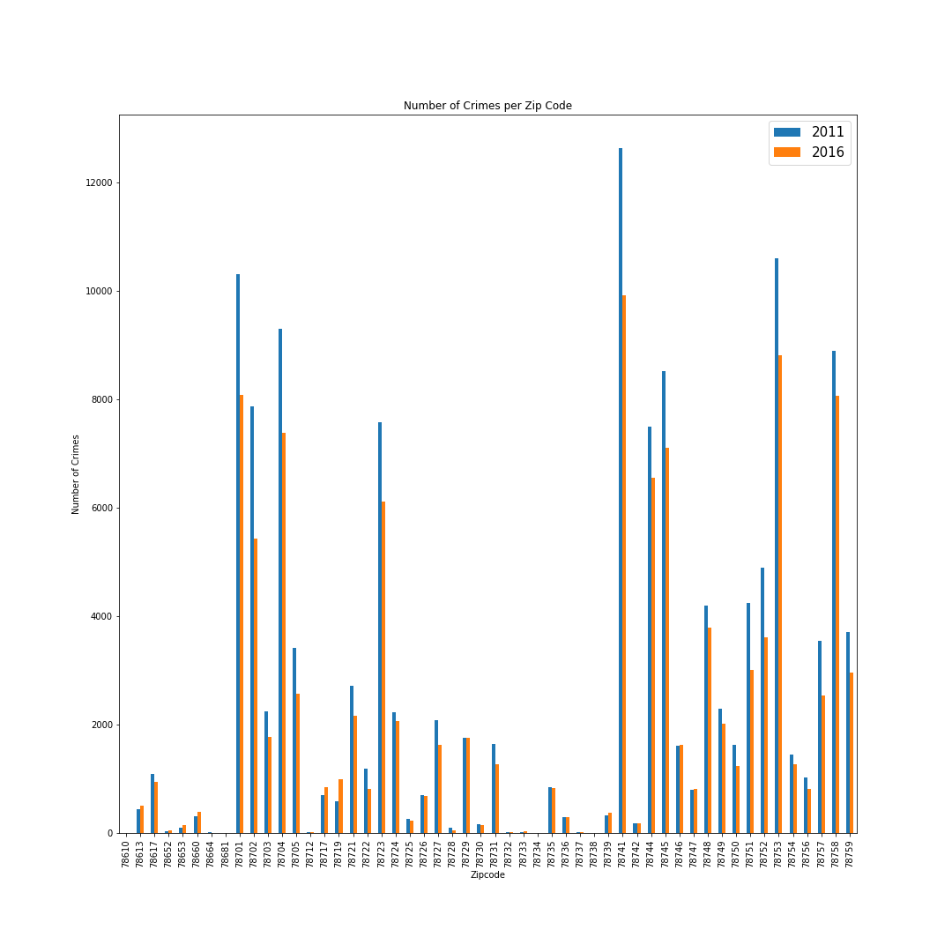
How have crime rates changed by zip code from 2011 to 2016?! All of Austin?!

Slide 6
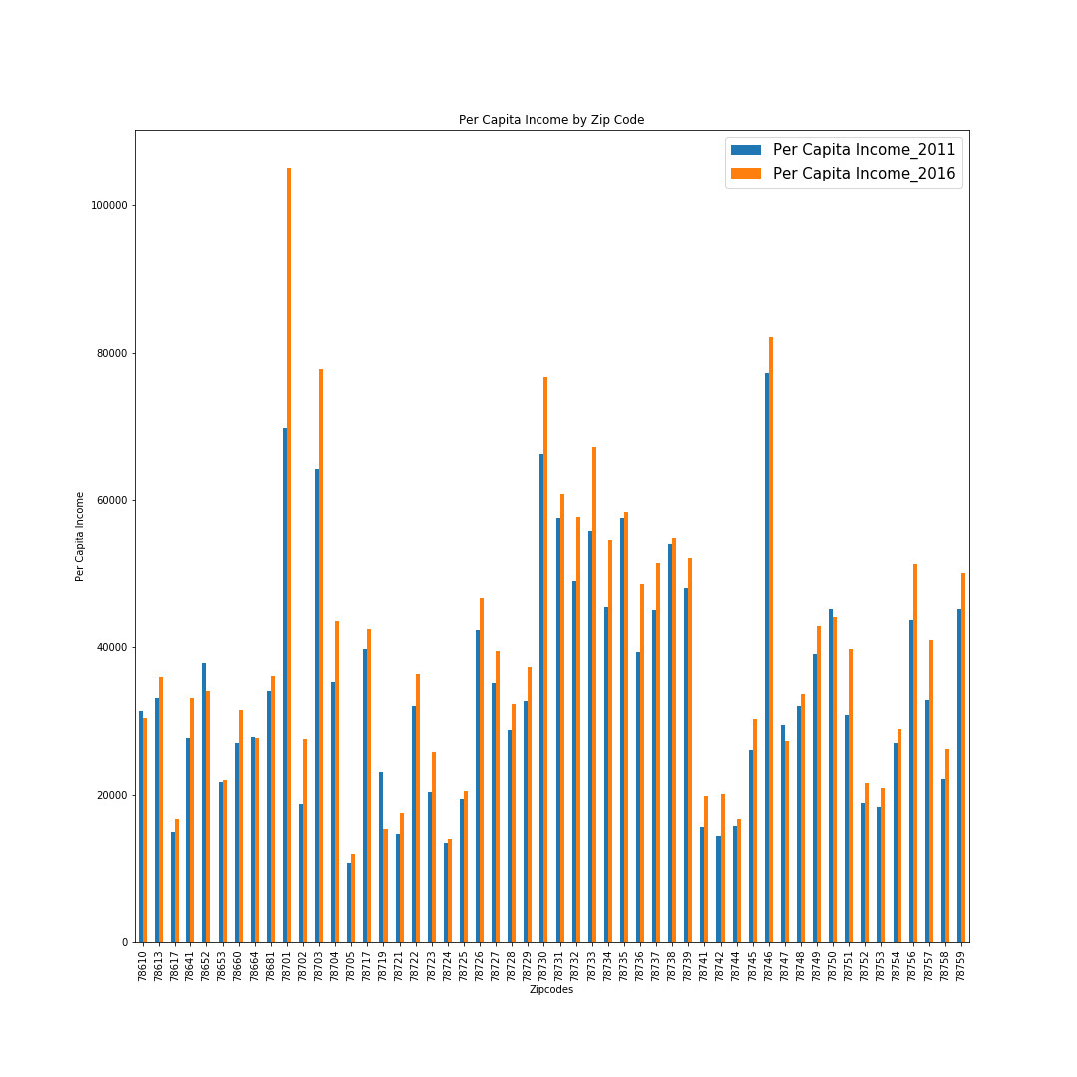
How have incomes changed by zip code from 2011 to 2016 (5 year look)?!

Slide 7
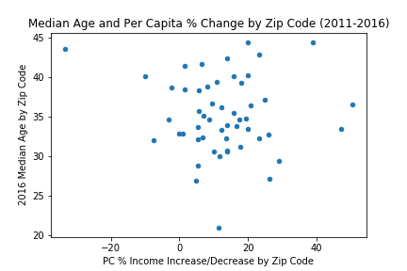
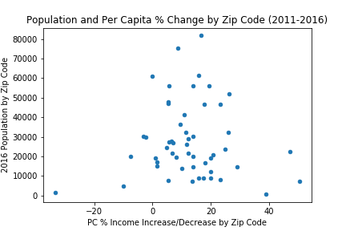
Does Age or population have an affect on income?! .
There does not appear to be a relationship between age or population, and per capita, percent change from 2011 – 2016.

Slide 8
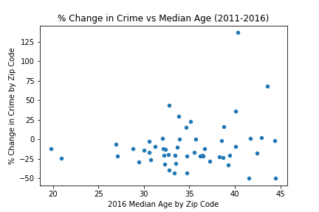
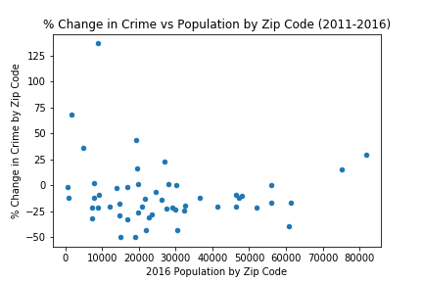
Does Age or population have an affect on crime?!
Crime went down across the board, for population or age and percent change in crime. There does not appear to be a correlation.

Slide 9
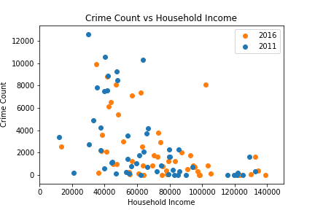
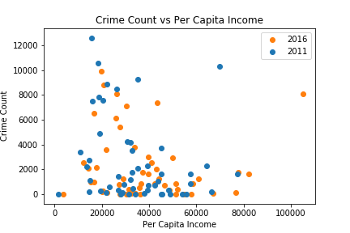
Is there a correlation between income and amount of crime?!
There seems to be a base amount of crime across incomes, but, when the crime rates exceed a count of 5,000-6,000, they are overwhelmingly in lower income areas.

Slide 10
Conclusions!
For the vast majority of Austin zip codes, the income has increased from 2011-2016.
For the majority of the zip codes in all of Austin, crime rates decreased from 2011-2016.
There is no significant correlation between the age/population and income.
Neither age nor population have a significant effect on crime.
There is a certain degree of correlation between income and crime.
For future research, deeper investigation can be taken to research different types of crime in zip codes.

